Slide 1
Deterministic Finite Automata

Slide 2
Finite Automata
Informally, a state diagram that comprehensively captures all possible states and transitions that a machine can take while responding to a stream or sequence of input symbols
Recognizer for “Regular Languages”
Deterministic Finite Automata (DFA)
The machine can exist in only one state at any given time
Non-deterministic Finite Automata (NFA)
The machine can exist in multiple states at the same time

Slide 3
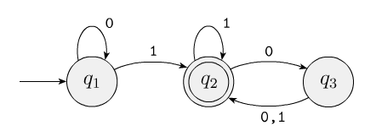
Deterministic Finite Automata (DFA)
In automata theory, a finite-state machine is called a deterministic finite automaton (DFA), if
each of its transitions is uniquely determined by its source state and input symbol, and
reading an input symbol is required for each state transition
Unique single path for each input and epsilon is excluded

Slide 4
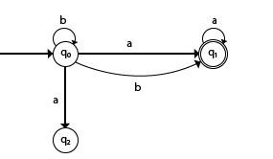
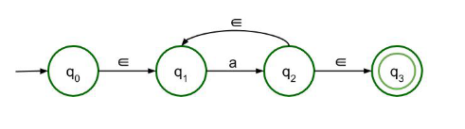
Non-deterministic Finite Automata (NFA)
A nondeterministic finite automaton (NFA), or nondeterministic finite-state machine, does not need to obey these restrictions.

Slide 5
Deterministic Finite Automata - Definition
A Deterministic Finite Automaton (DFA) consists of:
Q ==> a finite set of states
∑ ==> a finite set of input symbols (alphabet)
q₀ ==> a start state
F ==> set of final states
δ ==> a transition function, which is a mapping between Q x ∑ ==> Q
A DFA is defined by the 5-tuple:
{Q, ∑ , q₀,F, δ }

Slide 6
What does a DFA do on reading an input string?
Input: a word w in ∑*
Question: Is w acceptable by the DFA?
Steps:
Start at the “start state” q₀
For every input symbol in the sequence w do
Compute the next state from the current state, given the current input symbol in w and the transition function
If after all symbols in w are consumed, the current state is one of the final states (F) then accept w;
Otherwise, reject w.

Slide 7
Regular Languages
Let L(A) be a language recognized by a DFA A.
Then L(A) is called a “Regular Language”.
What is the position of regular languages in the Chomsky Hierarchy

Slide 8
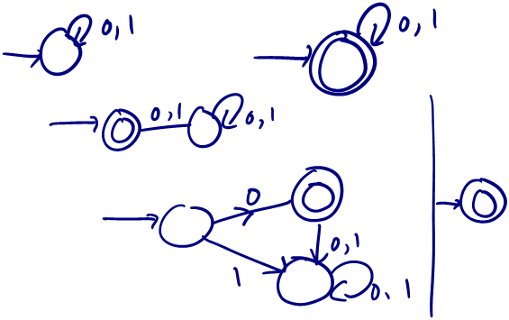
DFA Construction
Assume Σ = {0, 1}
L = ∅, L = Σ∗, L = {ɛ}, L = {0}.

Slide 9
DFA for strings containing 01
What makes this DFA deterministic?
Q = {q₀,q₁,q₂}
∑ = {0,1}
start state = q₀
F = {q₂}
Transition table
1
0
0,1
start
0
1
q₀
q₁
q₂
Final
state
symbols
0
1
q₀
q₁
q₀
states
q₁
q₁
q₂
*q₂
q₂
q₂

Slide 10
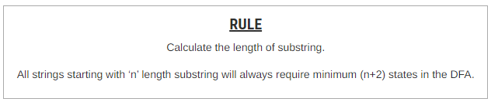
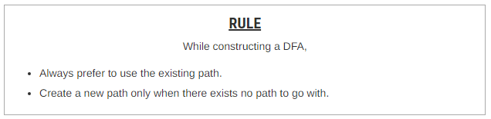
Steps for DFA construction
Determine the minimum number of states required in the DFA.
Decide the strings for which DFA will be constructed.
Construct a DFA for the strings decided in Step-02.
Send all the left possible combinations to the dead state.

Slide 11


A DFA Convention
We don't draw multiple arrows with the same source and destination states:
Instead, we draw one arrow with a list of symbols:

Slide 12
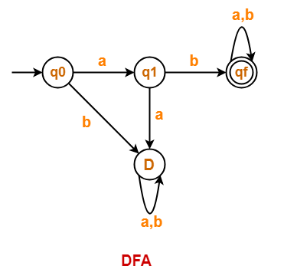
DFA Examples
Draw a DFA for the language accepting strings starting with ‘ab’ over input alphabets ∑ = {a, b}
Step-01:
All strings of the language starts with substring “ab”.
So, length of substring = 2.
Thus, Minimum number of states required in the DFA = 2 + 2 = 4.
It suggests that minimized DFA will have 4 states.
Step-02:
We will construct DFA for the following strings-
ab
aba
abab

Slide 13
Examples
Draw a DFA for the language accepting strings starting with ‘a’ over input alphabets ∑ = {a, b}
Design a DFA with ∑ = {0, 1} that accepts those strings which starts with 1 and ends with 0.
Design a DFA with ∑ = {0, 1} that accepts even number of 0's and even number of 1's.
Draw a DFA for the language accepting strings starting with ‘101’ over input alphabets ∑ = {0, 1}
Design a DFA that accepts only two words baa & ab
Design a DFA that accepts all words with triple letters either aaa or bbb over input alphabets ∑ = {a, b}
Design a DFA that accepts all words that have different first and last letters. If the word begins with an ‘a’ then it must ends with a ‘b’ and vice versa.

Slide 14
A Classic Riddle
A man must cross river with wolf, goat and cabbage
Has rowboat w/ room for man plus one possession
If left alone together:
Wolf eats goat
Goat eats cabbage
How can the man cross without loss?

Slide 15
Solutions As Strings
Four moves can be encoded as four symbols:
Man crosses with wolf (w)
Man crosses with goat (g)
Man crosses with cabbage (c)
Man crosses with nothing (n)
Then sequence of moves is a string, such as
gnwgcng:
First cross with goat, then cross back with nothing, then cross with wolf, …

Slide 16

Moves As State Transitions
Each move takes our puzzle universe from one state to another
For example, the g move is a transition between these two states:

Slide 17
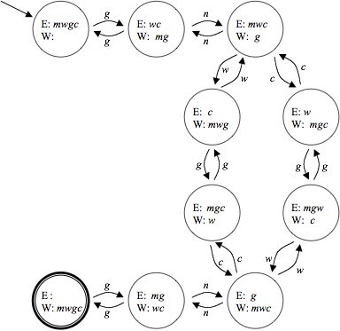
Transition Diagram
Showing all legal moves
All reachable states
Start state and goal state

